Slide 1
PRESENTATION
ZHIJIE HUANG
SAIER GONG

Slide 2
Introducing and ensembling several models in the reich lab website:
Umass - MechBayes
UCLA – SuEIR
Imperial College (model1, model2, model3)
Ensemble Model

Slide 3
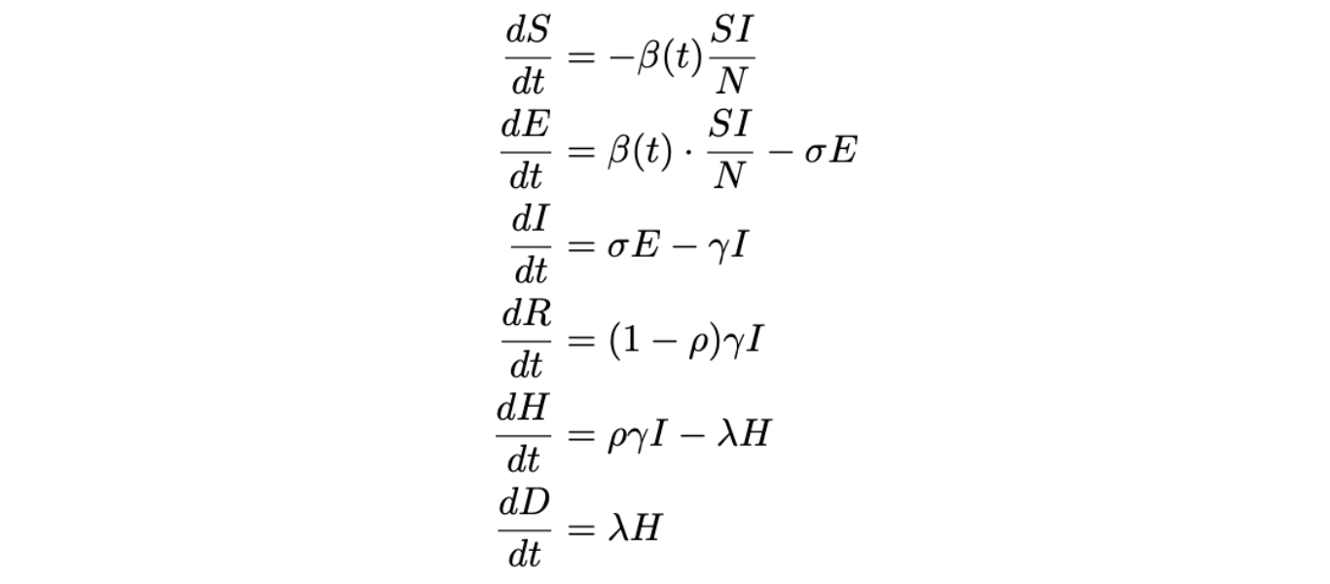
UMASS - MECHBAYES
Comparing with traditional SEIRD model, there is one more status- H, which is hospitalized-and-will-die, between I and D.

Slide 4
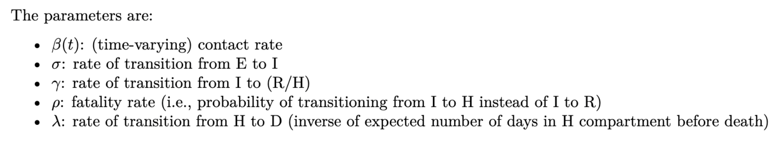
PARAMETER MEANING
Model uses a time-dependent beta

Slide 5
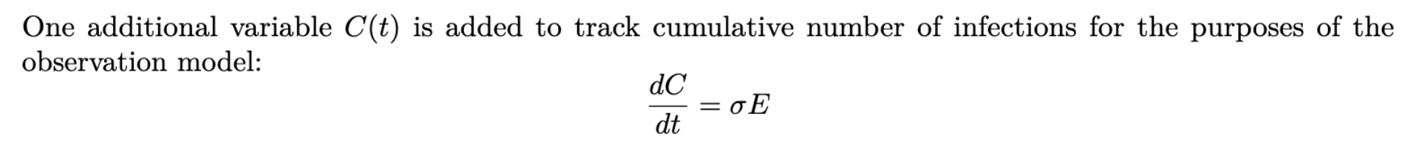
ONE MORE VARIABLE

Slide 6
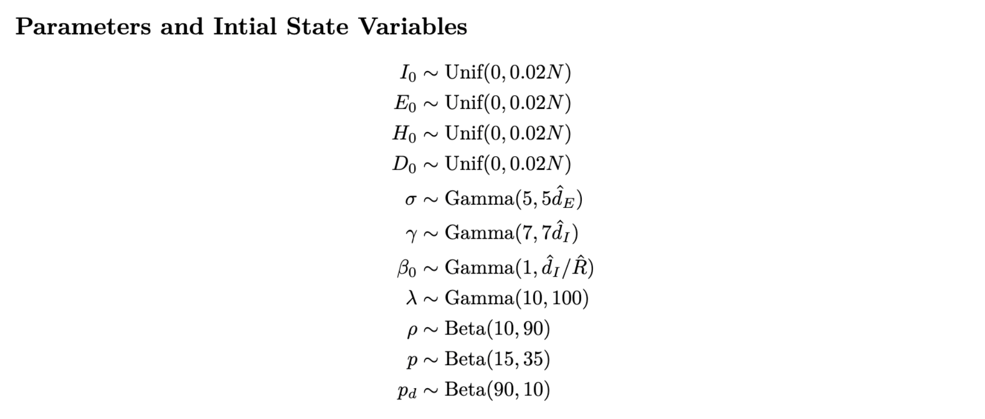
INITIAL VALUE

Slide 7
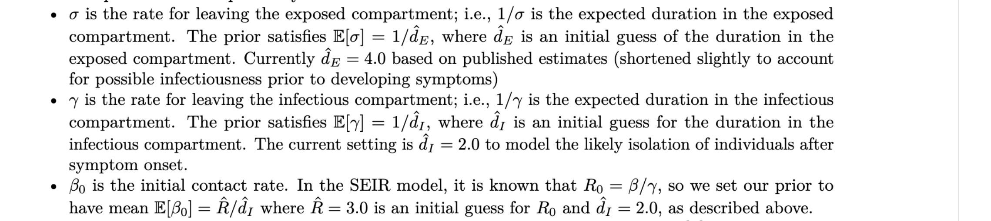
EXPLANATIONS OF THESE DISTRIBUTIONS

Slide 8
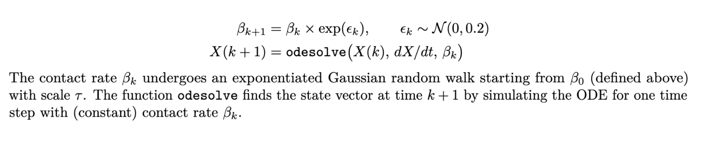
ABOUT TIME-DEPENDENT BETA

Slide 9
PARAMETER ESTIMATION-SQUARE LOSS
Here we use the square loss between the true number of total deaths and the predicted number of total death as the objective function, to minimize it.

Slide 10
NOTE:
Since the fitted value and prediction value are far away from the observed value, we give up aggregating UMass model into our ensemble model.

Slide 11
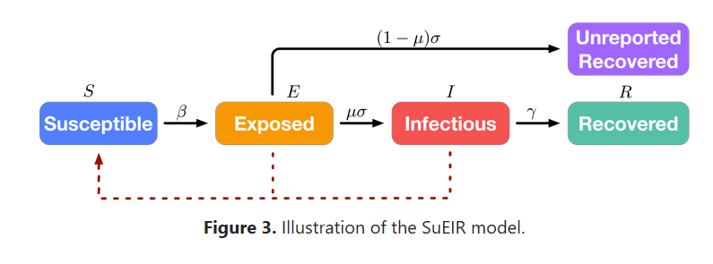

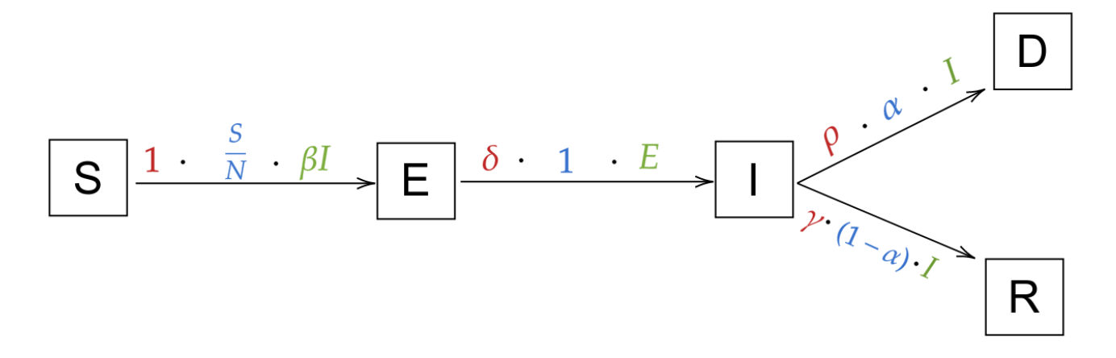

UCLA - SUEIR
We assume that there are much amount of unreported recovered population, thus we add a U status like the picture on the top. Then, to predict the number of total deaths, we also include Deaths status like the following picture.

Slide 12
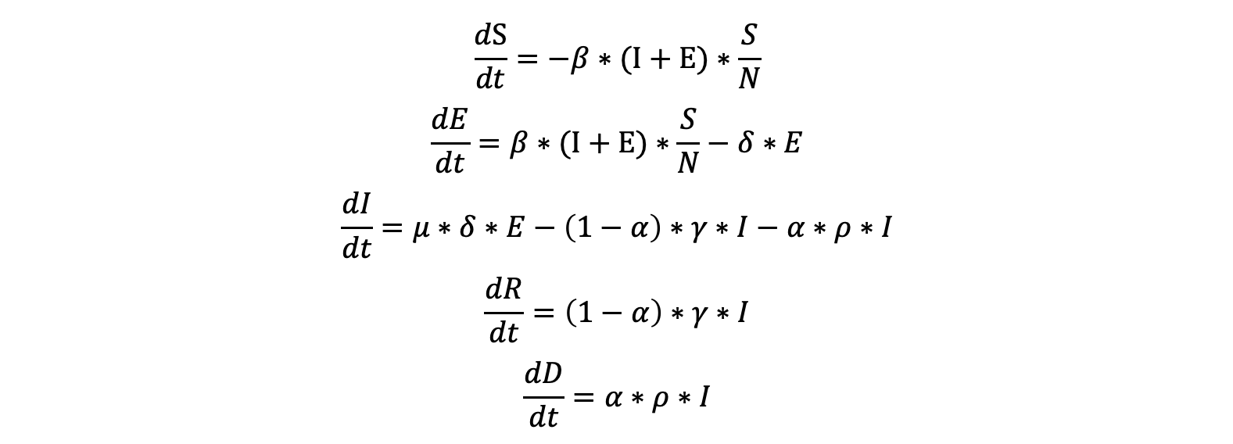
ODE

Slide 13
PARAMETER ESTIMATION
Here we use the square loss between the number of observations and predictions in deaths as the objective function.

Slide 14
PREVIOUS WEEK PREDICTIONS
810429.5
[1] 900.2386
DATE | predictions | observations
7/25 | 148988.2 | 146965
7/26 | 149861.1 | 147442
7/27 | 150732.0 | 148567
7/28 | 151600.7 | 149927
7/29 | 152467.4 | 151360
7/30 | 153332.1 | 152573
7/31 | 154194.7 | 153814
MSE= 2768843
RMSE=1663.984

Slide 15
FORECASTING IN DEATHS 8/1-8/7
DATE | predictions
08/01 | 155055.2
08/02 | 155913.7
08/03 | 156770.2
08/04 | 157624.6
08/05 | 158477.0
08/06 | 159327.4
08/07 | 160175.8

Slide 16
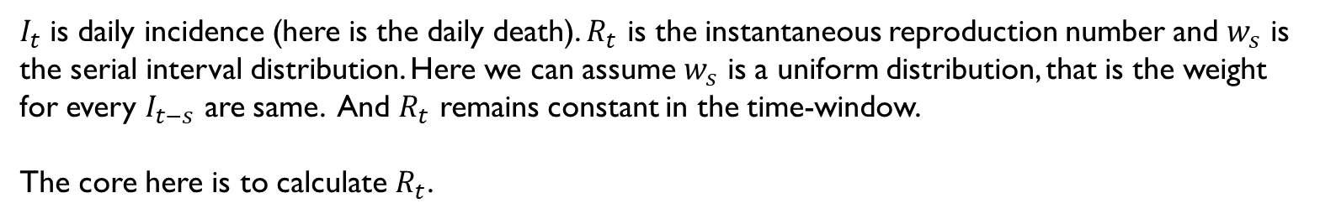
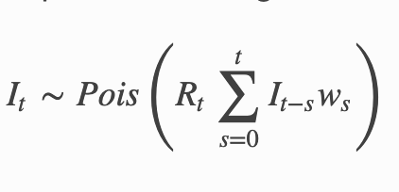
IMPERIAL COLLEGE (MODEL 1):
TIME-WINDOW 7 DAYS

Slide 17
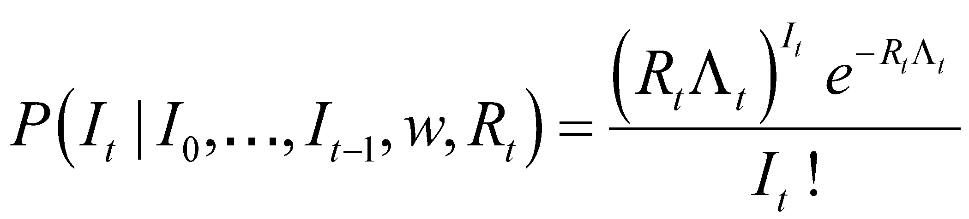
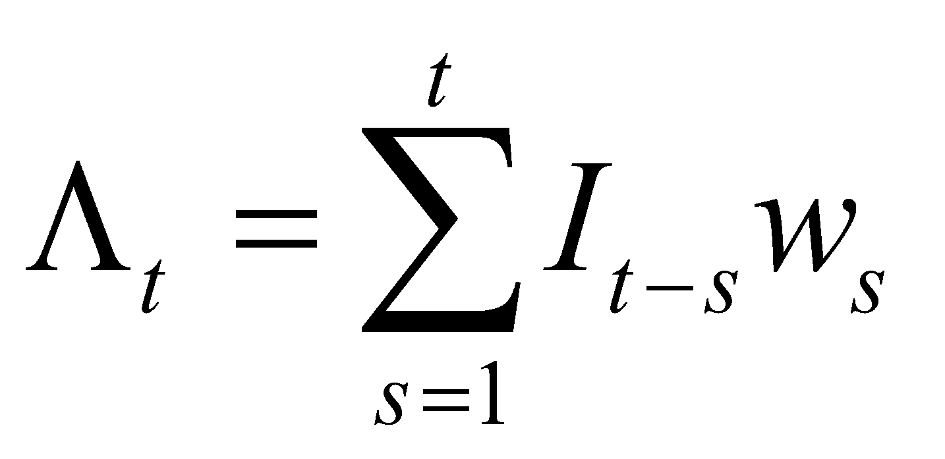
How we choose Rt
We assume the prior of Rt is a Gamma distribution with mean = the mean of transmission rate of the past 7 days, and sd = the sd of the transmission rate of the past 7 days (in our code, we define the
today’s transmission rate = today’s number of existing infectious people / yesterday’s number of existing infectious people).
And we can calculate the likelihood of It.

Slide 18
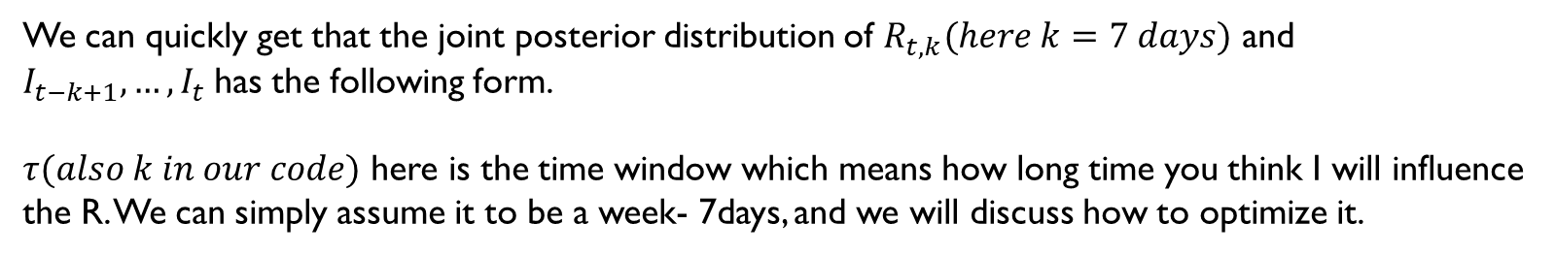
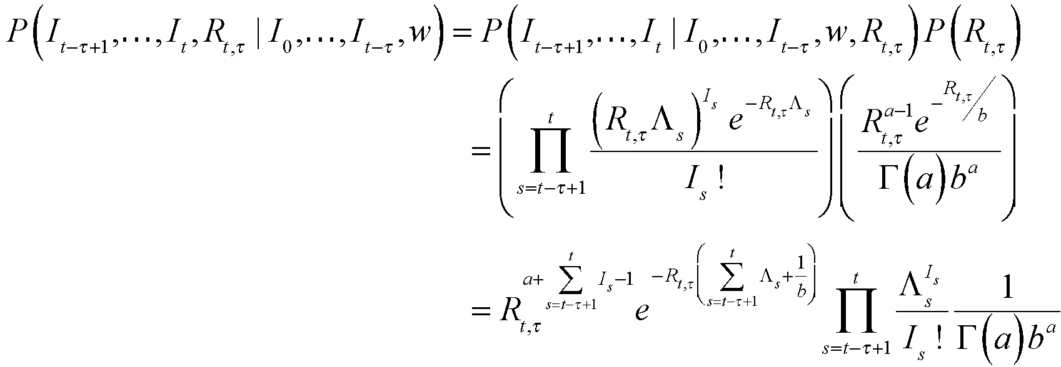
ESTIMATE RT AND DAILY INCIDENCE IN THE TIME-WINDOW

Slide 19
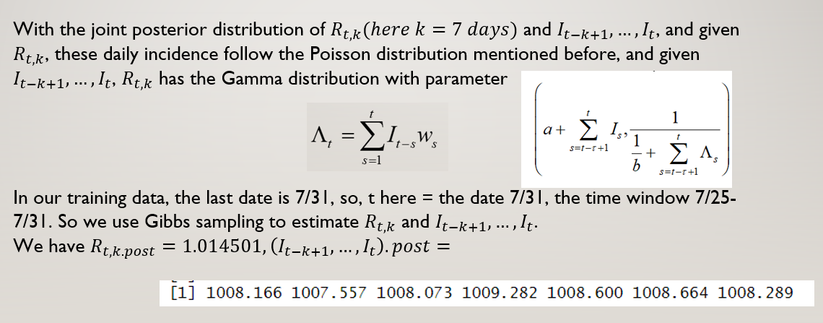

Slide 20
PREVIOUS WEEK PREDICTIONS
DATE | predictions | observations
7/25 | 147083.9 | 146965
7/26 | 148093.8 | 147442
7/27 | 149104.2 | 148567
7/28 | 150113.9 | 149927
7/29 | 151123.1 | 151360
7/30 | 152134.6 | 152573
7/31 | 153146.2 | 153814
MSE=208120.2
RMSE=456.2019

Slide 21
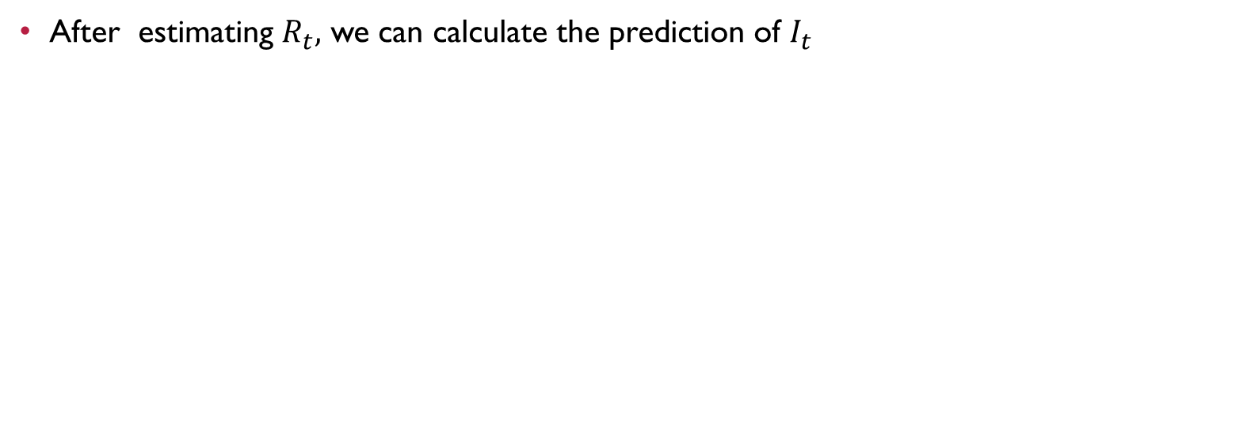
(SHORT TERM FORECAST)

Slide 22
WHEN CHOOSING THE LENGTH OF TIME-WINDOW=7 DAYS FORECASTING IN DEATHS 8/1-8/7
DATE | predictions
08/01 | 154828
08/02 | 155843
08/03 | 156856
08/04 | 157871
08/05 | 158886
08/06 | 159903
08/07 | 160917

Slide 23
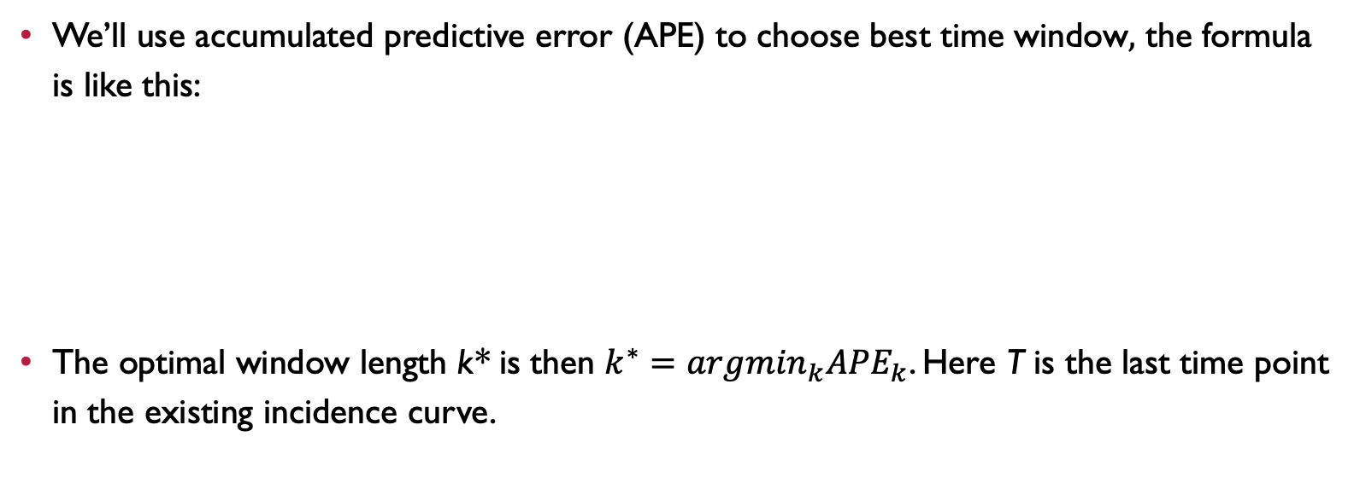
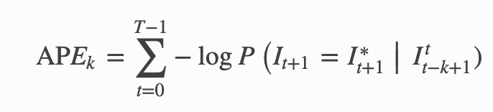
IC(MODEL2):
CHOICE OF TIME WINDOW - K

Slide 24
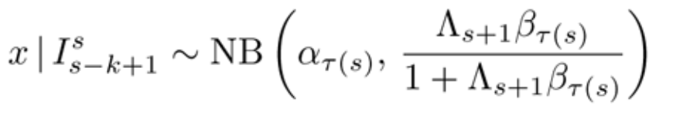
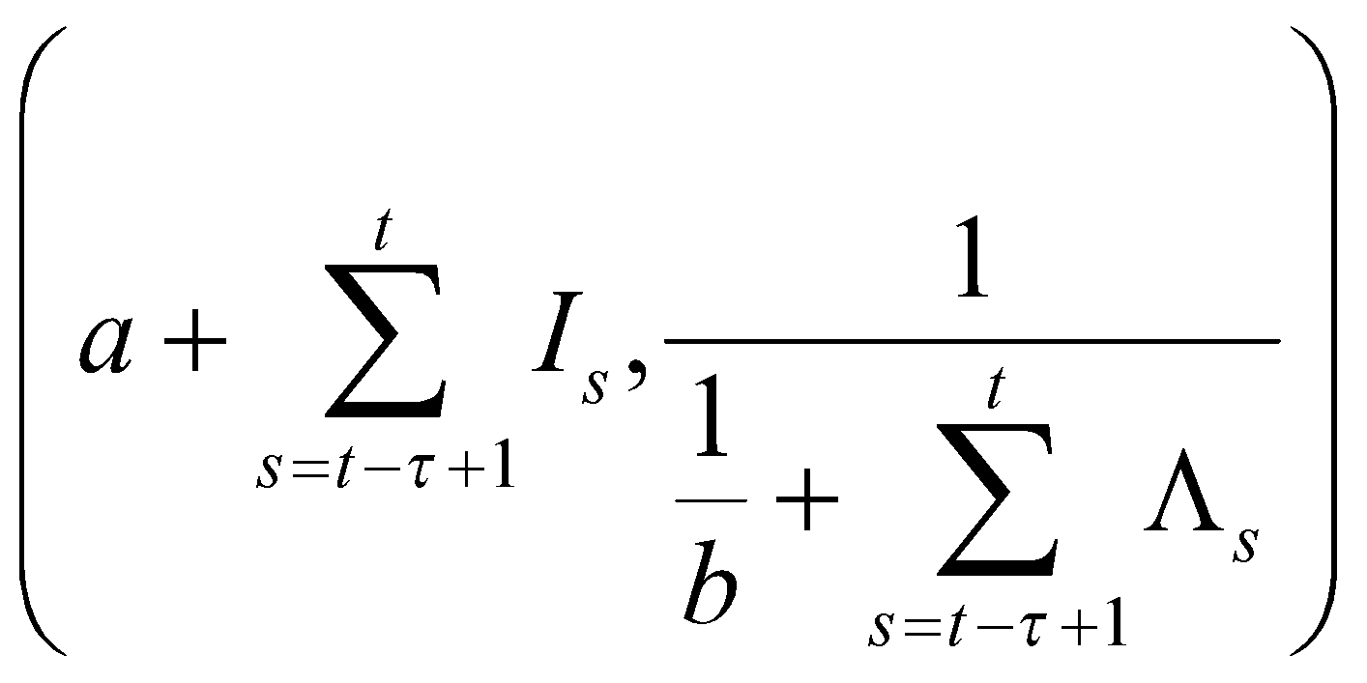
WHAT IS I’S DISTRIBUTION?

Slide 25
K.BEST=2 PREVIOUS WEEK PREDICTIONS
DATE | predictions | observations
7/25 | 146965.9 | 146965
7/26 | 147961.6 | 147442
7/27 | 148959.4 | 148567
7/28 | 149561.7 | 149927
7/29 | 150557.8 | 151360
7/30 | 152363 | 152573
7/31 | 153367 | 153814
MSE= 722497
RMSE=849.9982

Slide 26
WHEN CHOOSING THE LENGTH OF TIME-WINDOW=2 DAYS FORECASTING IN DEATHS 8/1-8/7
DATE | predictions
08/01 | 154824.8
08/02 | 155833.8
08/03 | 156844.0
08/04 | 157857.0
08/05 | 158864.3
08/06 | 159875.1
08/07 | 160887.6

Slide 27

IC (MODEL3):
First, we have a known distribution for delay from report to death (gamma distribution with mean 10 days and standard deviation 2 days)
This is a kind of distribution to represent the probability of how long a Infectious people will switch to death state.

Slide 28
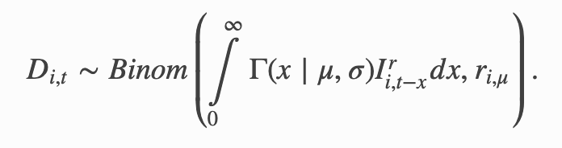
HOW TO PREDICT DEATH?
Based on distribution of delay before, if we have a estimated Infectious I, and a death rate r, we can get the Death prediction by a binomial distribution.

Slide 29
HOW CAN WE GET R AND I?
we estimate new reporting cases in the coming week by sampling from a Gamma distribution with mean and standard deviation estimated from the number of observed cases in the last week.
r is the estimated ratio of deaths to reported cases for the last week of data

Slide 30
TO PREDICT DEATHS
We already have I, r from last week’s data and delay distribution. We can calculate the first part parameter in binomial distribution by weighted summing I data based on delay distribution. And simulate a binomial distribution to get the predicted D.

Slide 31
Since this process refers to two random sampling, we’ll do this process 5000 times and get the mean of those results.

Slide 32
PREVIOUS WEEK PREDICTIONS
DATE | predictions | observations
7/25 | 147019 | 146965
7/26 | 147968 | 147442
7/27 | 148924 | 148567
7/28 | 149773 | 149927
7/29 | 150686 | 151360
7/30 | 151572 | 152573
7/31 | 152449 | 153814
MSE=449100.7
RMSE=670.1498

Slide 33
SHORT TERM FORECASTING IN DEATHS
DATE | predictions
08/01 | 154962.5
08/02 | 156109.5
08/03 | 157235.5
08/04 | 158331.6
08/05 | 159412.1
08/06 | 160497.3
08/07 | 161601.7

Slide 34

4 MODEL ENSEMBLE
Since we have coded 5 models(UMASS, UCLA and 3 IC models), we decide to set the weights based on their performance in the previous week(7/25-7/31)—RMSE.
MODEL | UMASS | UCLA | IC(7 DAYS) | IC(2 DAYS) | IC(model 3)
RMSE | N/A | 1663.984 | 456.2019 | 849.9982 | 670.1498
WEIGHT | N/A | 0.1100 | 0.4013 | 0.2154 | 0.2732

Slide 35
The result of ensemble model of the previous week
DATE | predictions | observations
7/25 | 147250.3 | 146965
7/26 | 148225.4 | 147442
7/27 | 149202.9 | 148567
7/28 | 150065.4 | 149927
7/29 | 151029.8 | 151360
7/30 | 152161.9 | 152573
7/31 | 153118.6 | 153814
MSE= 268601.9
RMSE= 518.2682

Slide 36
FINAL FORECASTING IN DEATHS 8/01-8/07
AND COMPARISON WITH REAL RESULT
Based on the weights in the ensemble model, we have the final predictions of total deaths:
DATE | predictions | TRUE
08/01 | 154889.1 | 154919
08/02 | 155921.6 | 155320
08/03 | 156947.7 | 155859
08/04 | 157966.7 | 157230
08/05 | 158980.1 | 158593
08/06 | 159996.0 | 159830
08/07 | 161016.2 | 161066

Slide 37
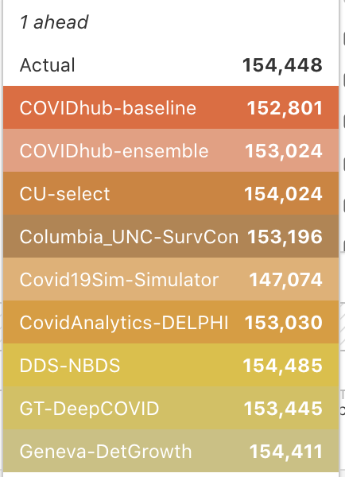
Prediction result on 08/03 comparison with Reich Lab model
DATE | predictions | TRUE
08/03 | 156947.7 | 155859
Since the source of data is different, the prediction and actual value are not completely identical. (We can see our true value and actual value on the reich lab website are not same)

Slide 38
THANK YOU!

